Slide 1
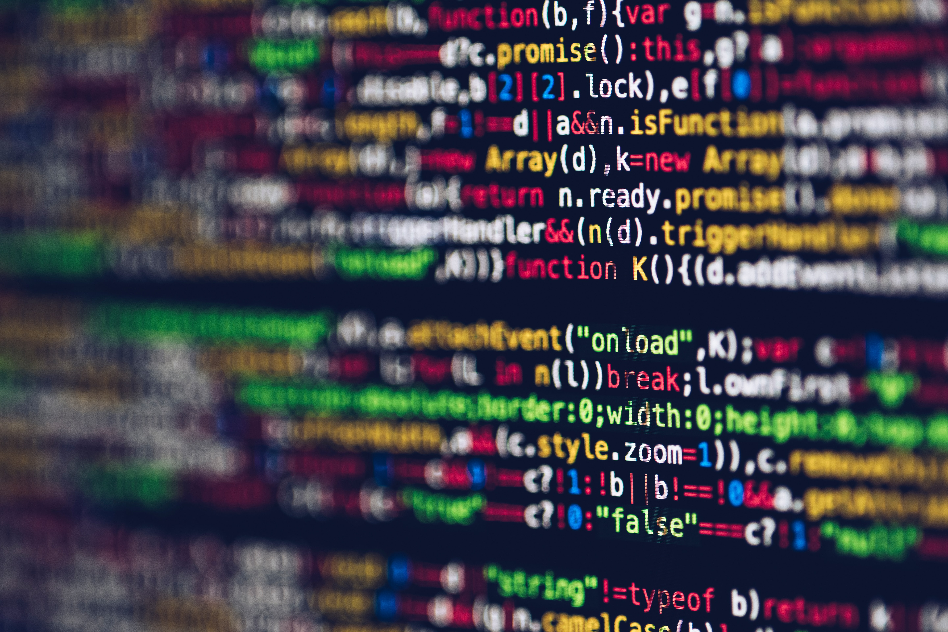

Session – 11
JavaScript-I
Prepared by: Sir Muhammad Hamza
1

Slide 2
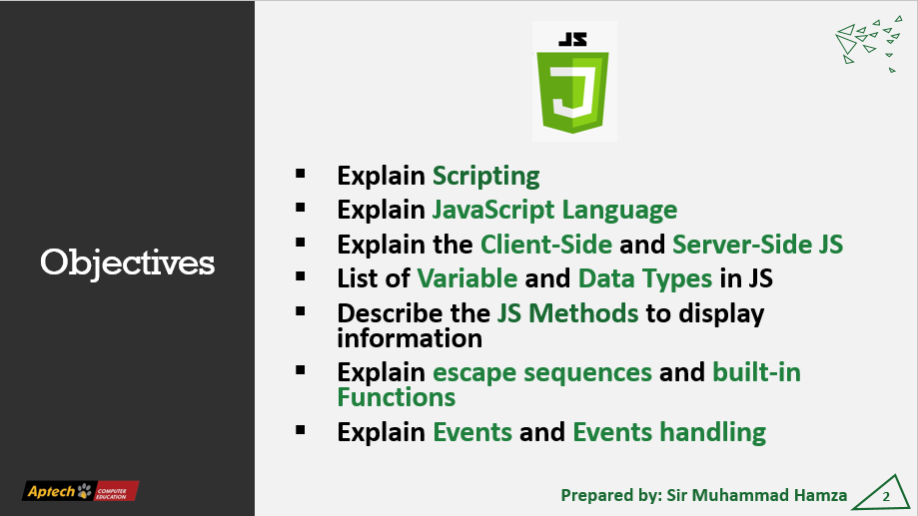

Slide 3
Introduction to JS
JavaScript is a scripting language that allows building dynamic Web pages by ensuring maximum user interactivity.
JavaScript is the world's most popular programming language.
It is lightweight and most commonly used as a part of web pages
JavaScript can update and change both HTML and CSS
98% of websites use JavaScript on the client side for webpage behavior.
Prepared by: Sir Muhammad Hamza
3

Slide 4
What is Scripting
Scripting refers to a series of commands that are interpreted and executed sequentially and immediately on occurrence of an event.
This event is an action generated by a user while interacting with a Web page.
Examples of events include button clicks, selecting a product from a menu, and so on.
Prepared by: Sir Muhammad Hamza
4

Slide 5
Scripting Languages Types
There are two types of scripting languages. They are as follows:
Client-side Scripting:
Refers to a script being executed on the client’s machine by the browser.
Server-side Scripting:
Refers to a script being executed on a Web server to generate dynamic HTML pages.
Prepared by: Sir Muhammad Hamza
5

Slide 6
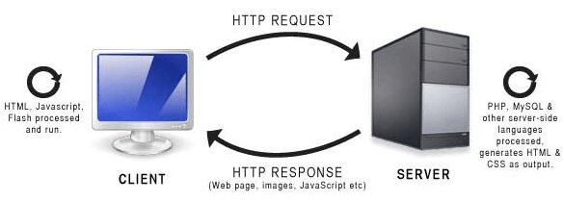
Scripting Languages Types
Prepared by: Sir Muhammad Hamza
6

Slide 7
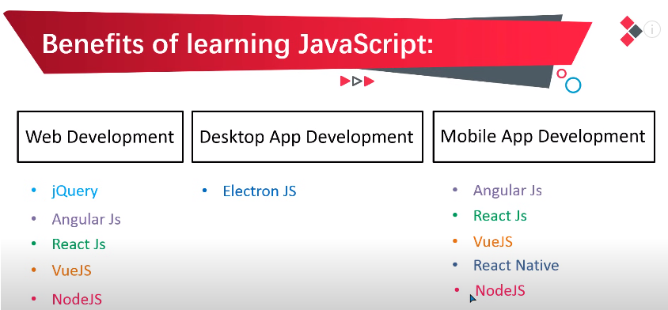

Slide 8
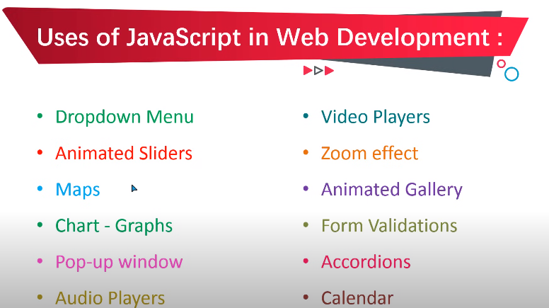

Slide 9
Method to add JS in HTML
Inpage
JavaScript
External JavaScript
Prepared by: Sir Muhammad Hamza
9

Slide 10
<script> Tag
You can place any number of scripts in an HTML document.
You can define multiple <script> tags in the <body>, or in the <head> section of an HTML page, or in both.
<script>
document.getElementById("demo").innerHTML = "My First JavaScript";
</script>
Prepared by: Sir Muhammad Hamza
10

Slide 11
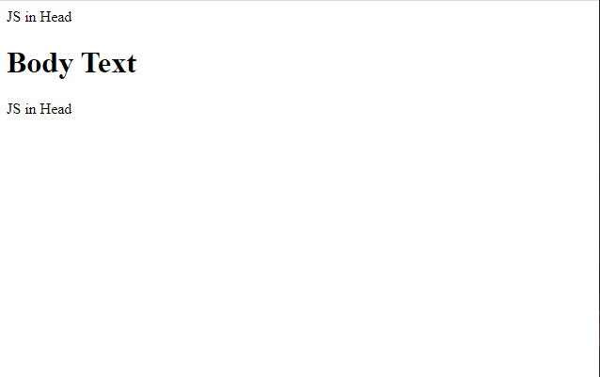
<script> Tag
<!DOCTYPE html>
<html lang="en">
<head>
<title>JS</title>
<script>
document.write("JS in Head");
</script>
</head>
<body>
</body>
</html>
Prepared by: Sir Muhammad Hamza
11

Slide 12
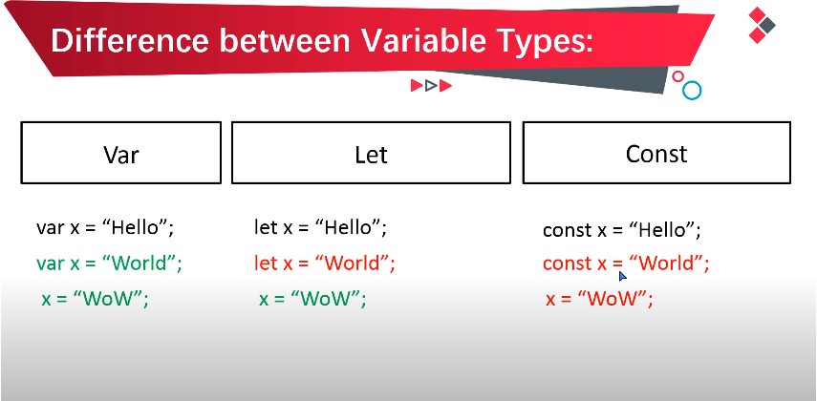

Slide 13
Variables in JS
What is Variable
<script>
var x = 5;
var y = 6;
var z = x + y;
document.getElementById("demo").innerHTML =
"The value of z is: " + z;
</script>
Variables are containers for storing data (storing data values).
In this example, x, y, and z, are variables, declared with the var keyword:
Prepared by: Sir Muhammad Hamza
13

Slide 14
Variables in JS
What is Variable
<script>
let x = 5;
let y = 6;
let z = x + y;
document.getElementById("demo").innerHTML =
"The value of z is: " + z;
</script>
4 Ways to Declare a JavaScript Variable:
Using var
Using let
Using const
Using nothing
Prepared by: Sir Muhammad Hamza
14

Slide 15
JS Data Types
Primitive Data Type
Non-Primitive Data Type
String
Number
Boolean
Null
Undefined
Object
Array
Prepared by: Sir Muhammad Hamza
15

Slide 16
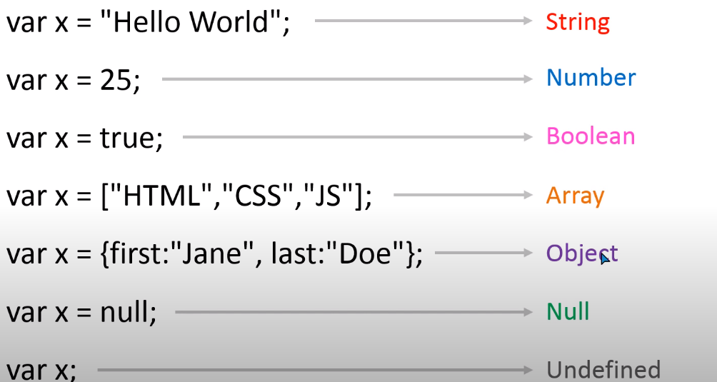

Slide 17
Session-2 End
Thank You
Any Question?
Prepared by: Sir Muhammad Hamza
17

Slide 18
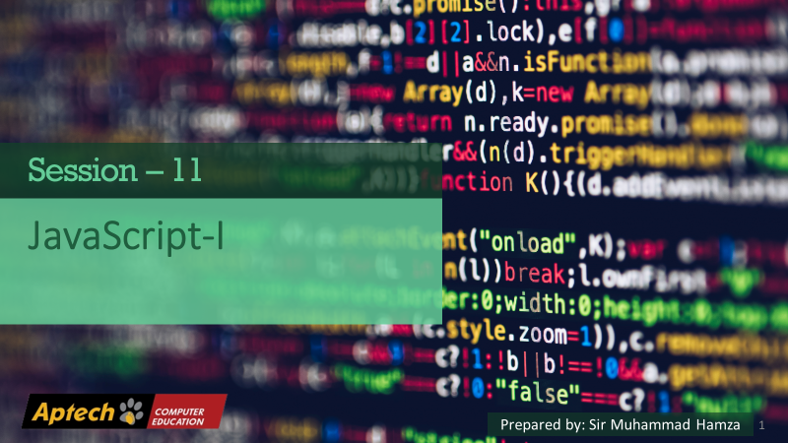
18

Slide 19
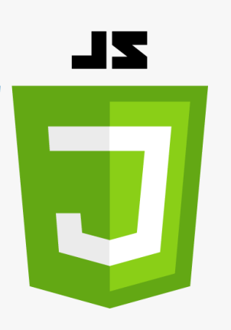
Objectives
Explain Operator and their types in JS.
Different type of Arithmetic operators.
Different type of Assignment operators.
Different type of Comparison operators.
Prepared by: Sir Muhammad Hamza

Slide 20
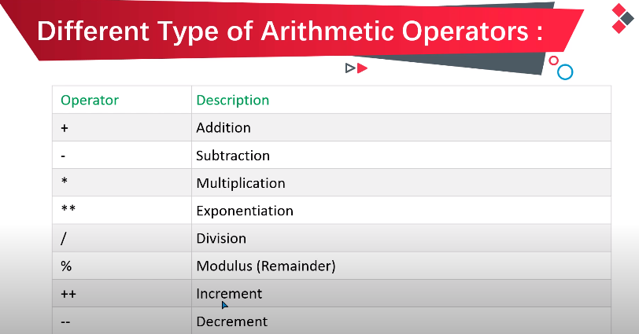

Slide 21
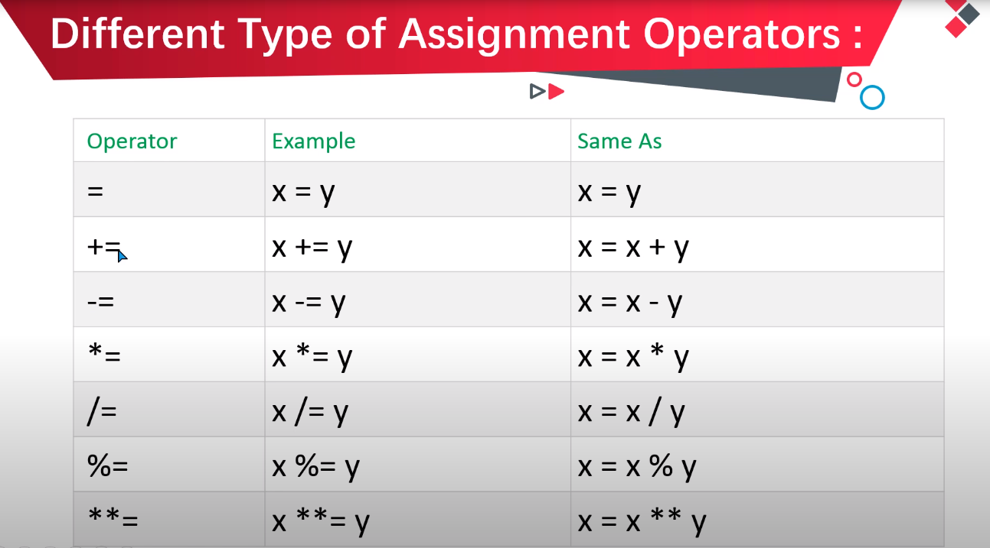

Slide 22
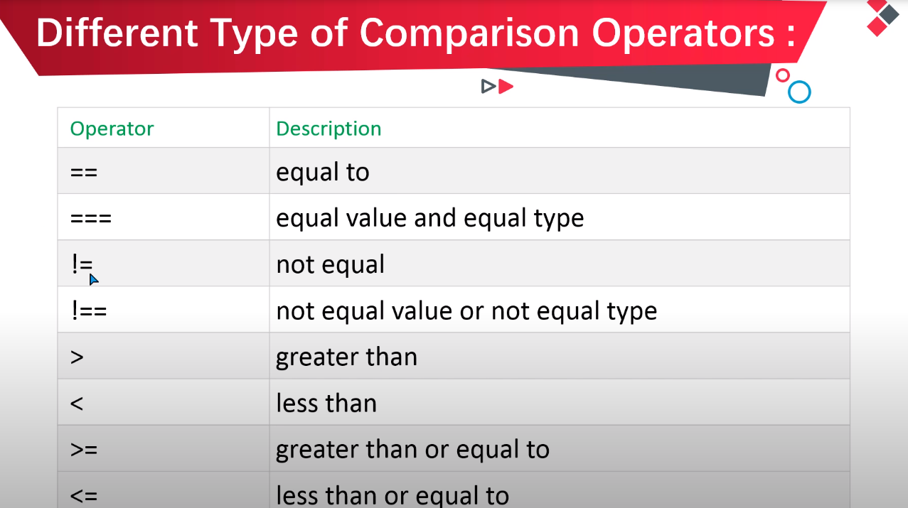

Slide 23
Session-2 End
Thank You
Any Question?
Prepared by: Sir Muhammad Hamza
23

Slide 24
24

Slide 25
Objectives
Explain decision making statements in JS.
Different Types of Logical Operators in JS.
What IF Statements.
IF Else Statement in Java Script.
IF Else IF Statement in Java Script.
Conditional Trinary Operator.
Switch Statement in JS.
Prepared by: Sir Muhammad Hamza

Slide 26
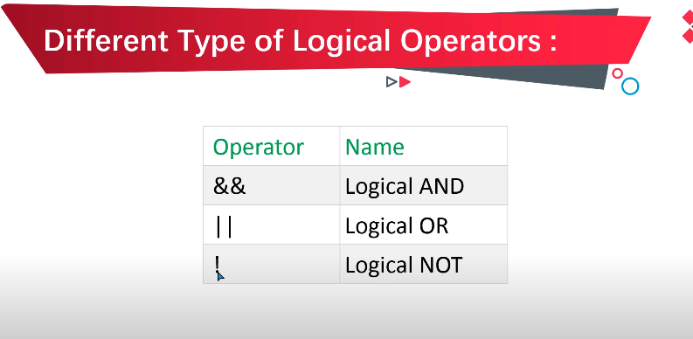

Slide 27
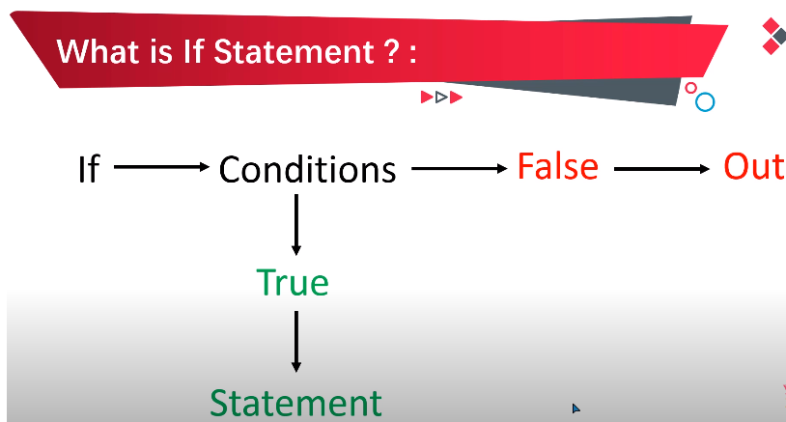

Slide 28
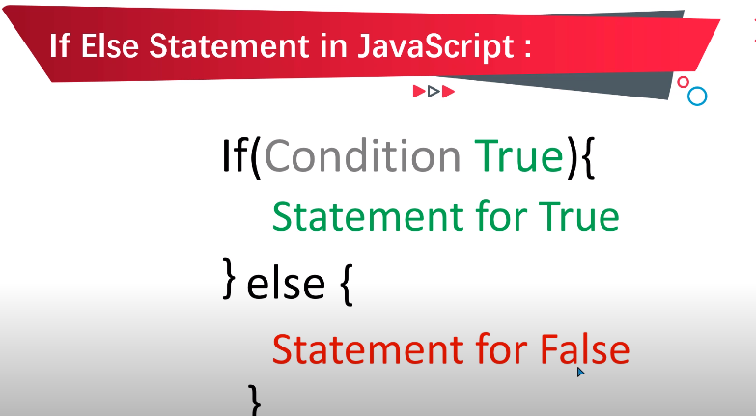
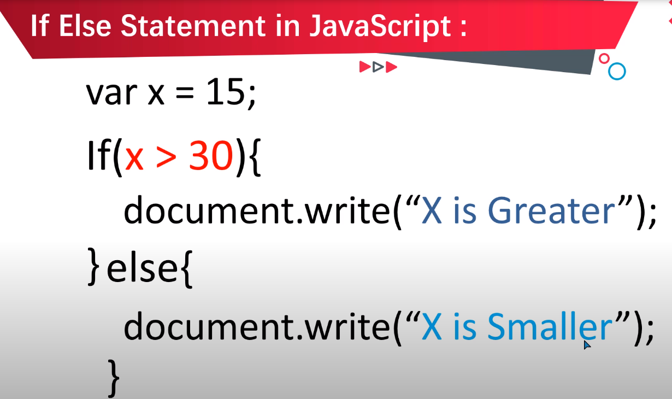

Slide 29
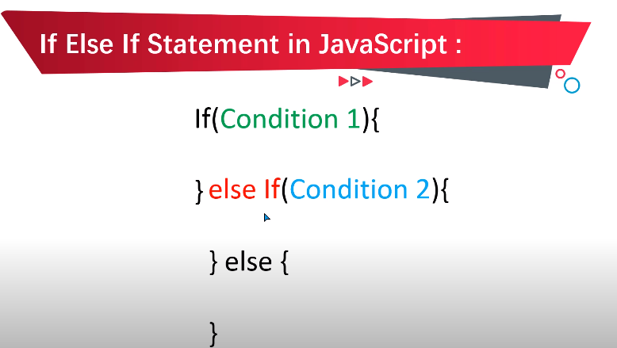
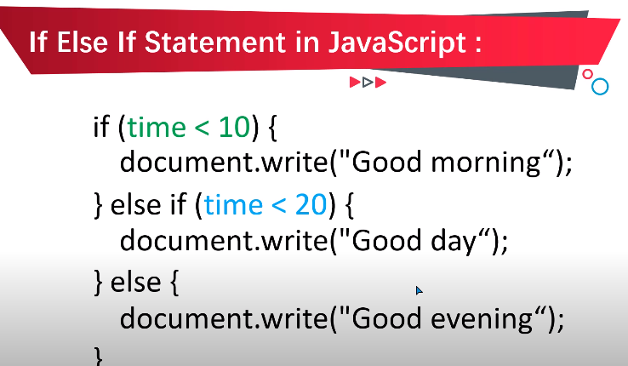

Slide 30
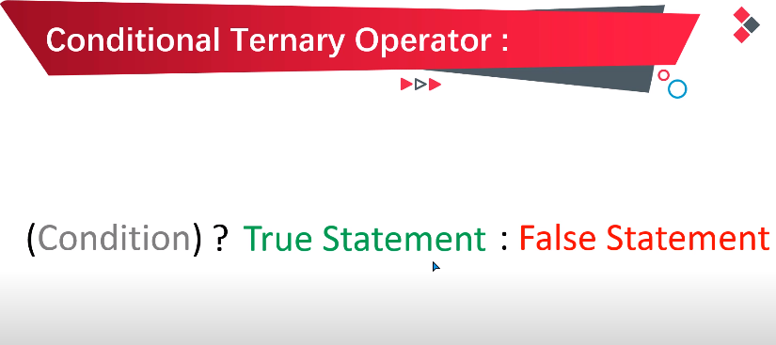
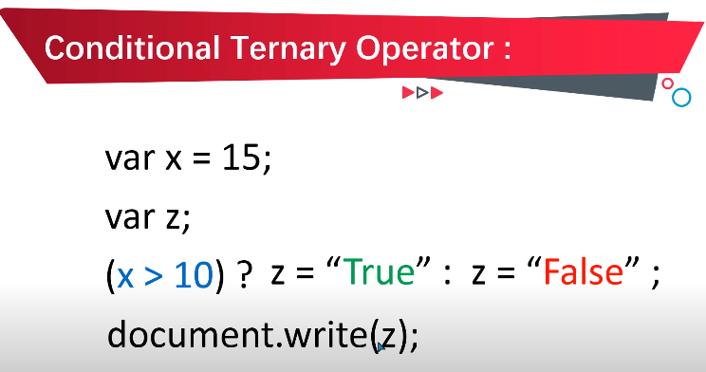

Slide 31
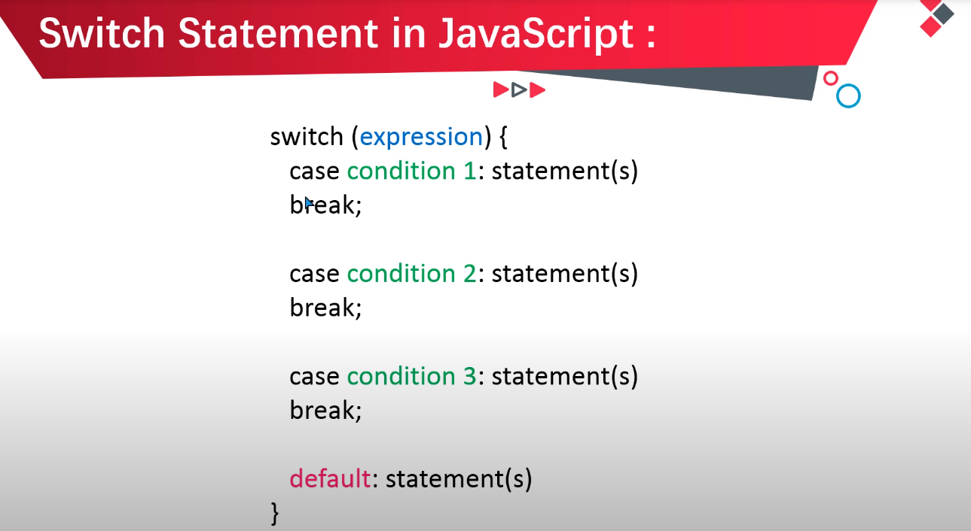

Slide 32
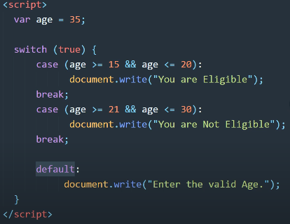

Slide 33
Session-2 End
Thank You
Any Question?
Prepared by: Sir Muhammad Hamza
33

